Slide 1
EUDICOTS

Slide 2
WHAT ARE EUDICOTS?
From Greek ‘eus’ means good or true.
Dicot short for dicotyledon.
EUDICOTS = HAVE TRUE DICOTYLEDON

Slide 3
WHAT ARE EUDICOTS?
Are flowering plants that posses two cotyledons
  (cotyledon – embryonic leaf of the plant)
There are more or less 320 families

Slide 4
Pittosporaceae

Slide 5

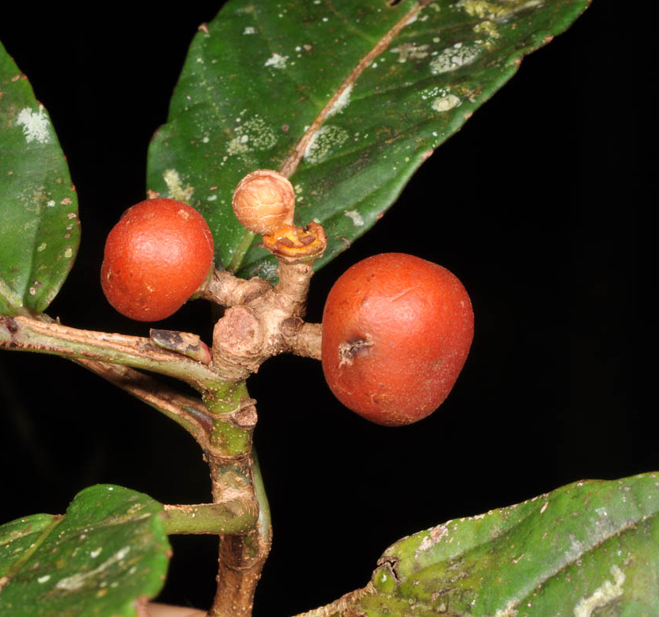
general characteristics

Slide 6
1.
Habit
tree / shrub / vine

Slide 7
2.
Leaves
shiny, coriaceous, entire

Slide 8
3.
Flowers
bisexual, floral pattern, small

Slide 9
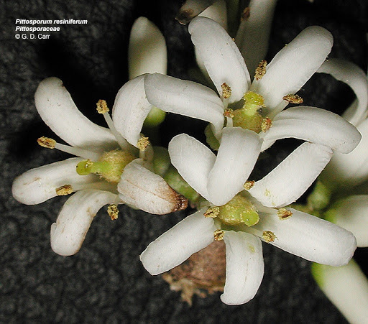
floral pattern

Slide 10

Floral diagram
K(5) C(5) A(5) G(2)
where,
K= calyx of 5 fused sepals are present
C= corolla of 5 fused petals are present
A= androecium of 5 fused stamen are present
G= gynoecium of 2 fused carpels are present

Slide 11
genera
Representative species and examples

Slide 12
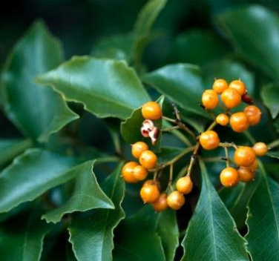
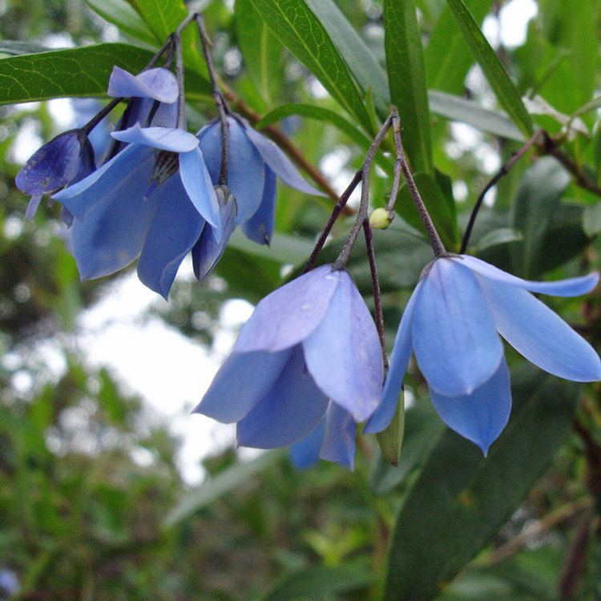

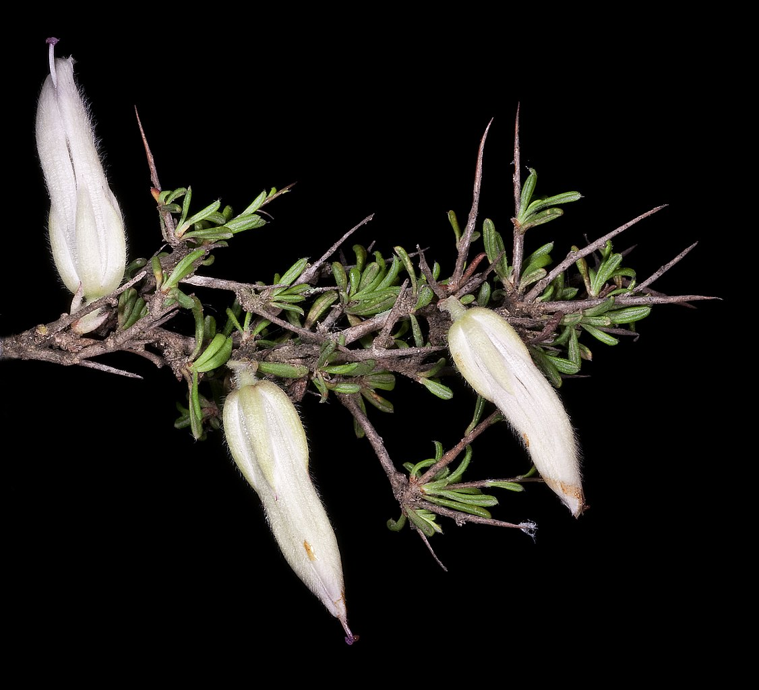
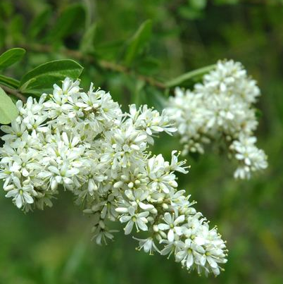
Pittosporaceae
Auranticarpa
Auranticarpa edentata L.W.Cayzer, Crisp & I.Telford
Billardiera
Billardiera drummondii (C.Morren) L.W.Cayzer & Crisp
Bentleya
Bentleya spinescens E.M.Benn.
Bursaria
Bursaria calcicola L.W.Cayzer, Crisp & I.Telford
.

Slide 13
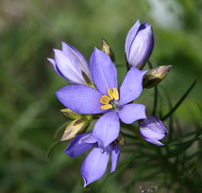
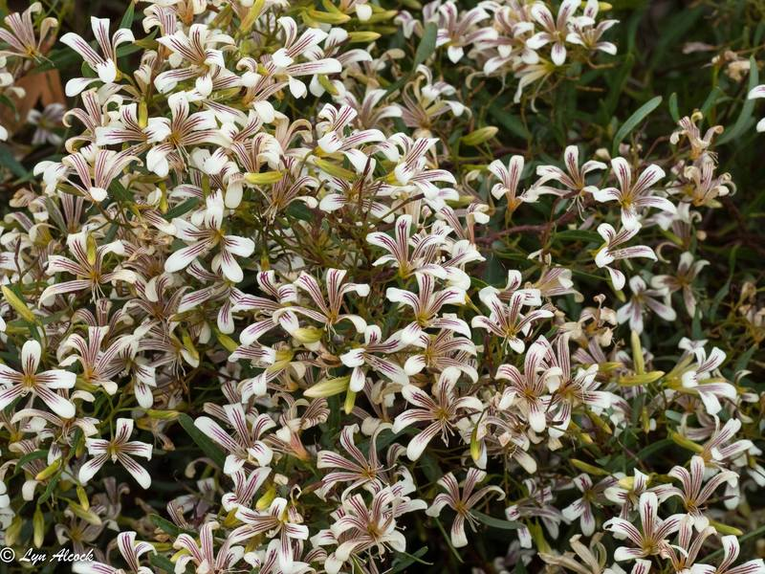
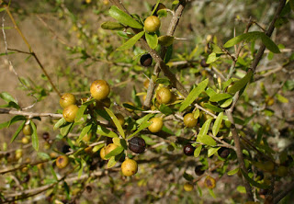
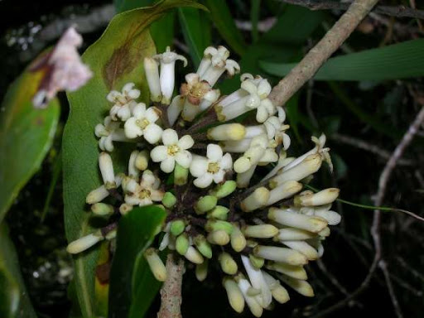
Pittosporaceae
Cheiranthera
Cheiranthera borealis (E.M.Benn.) L.W.Cayzer & Crisp
Marianthus
Marianthus mollis
(E.M. Benn.) L.W. Cayzer & Crisp
Citriobatus, Citriobatus linearis (F.M.Bailey) C.T.White.
Pittosporum
Pittosporum glomeratum var. acutisepalum
Hillebr
.

Slide 14
Economic importance
Ornamental plant
Medicinal purposes
(some species do contain toxins)

Slide 15
Vitaceae

Slide 16
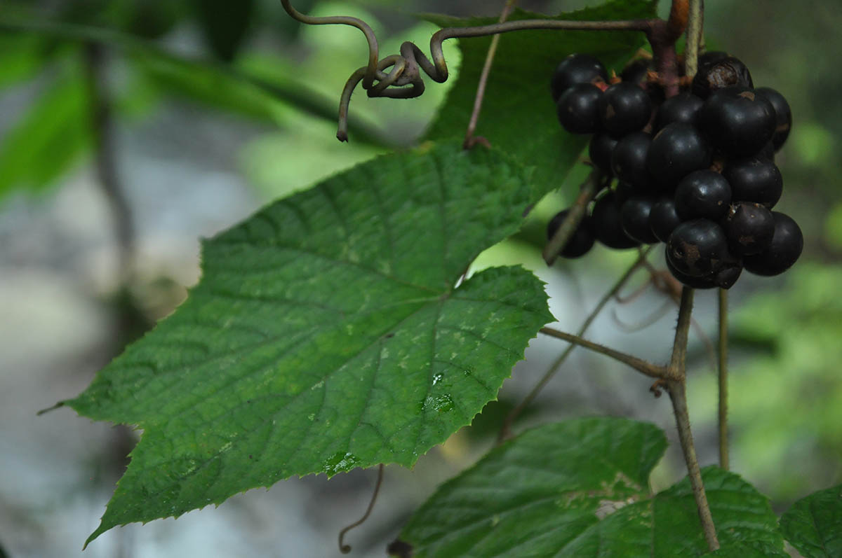
general characteristics

Slide 17
1.
Habit
shrub / vine

Slide 18
2.
Leaves
palmately compound, rough and gritty
modified leaves

Slide 19
3.
Flowers
inflorescence, very small,

Slide 20
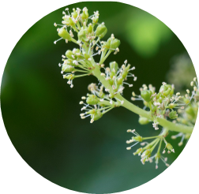
floral pattern

Slide 21
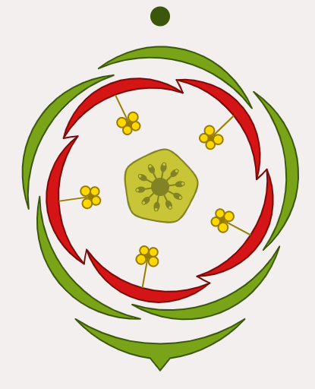
Floral diagram
K(5) C5 A5 G(2)
where,
K= calyx of 5 fused sepals are present
C= corolla of 5 separated petals are present
A= androecium of 5 separated stamen are present
G= gynoecium of 2 fused carpels are present

Slide 22
genera
Representative species and examples

Slide 23
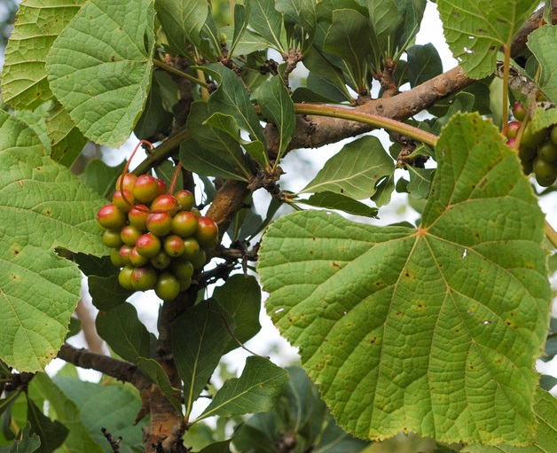
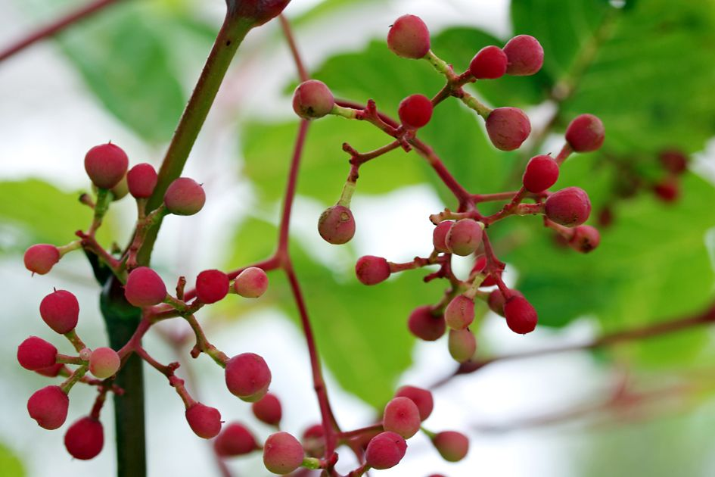
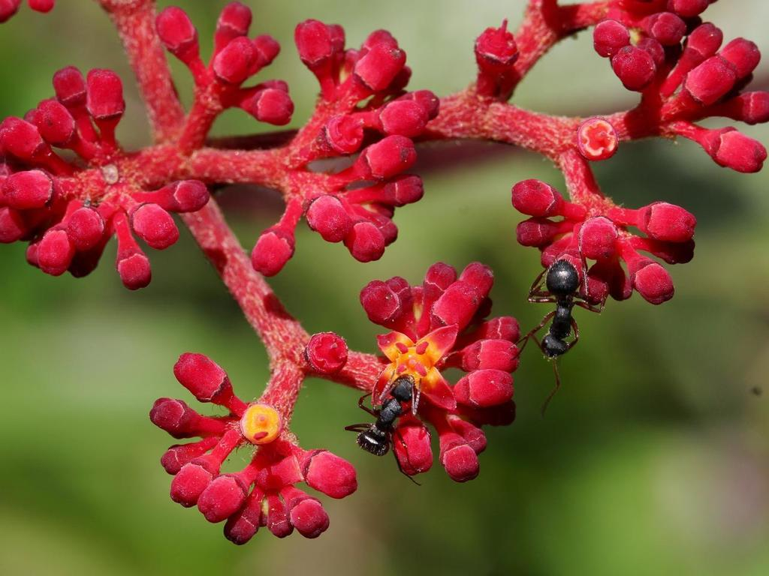
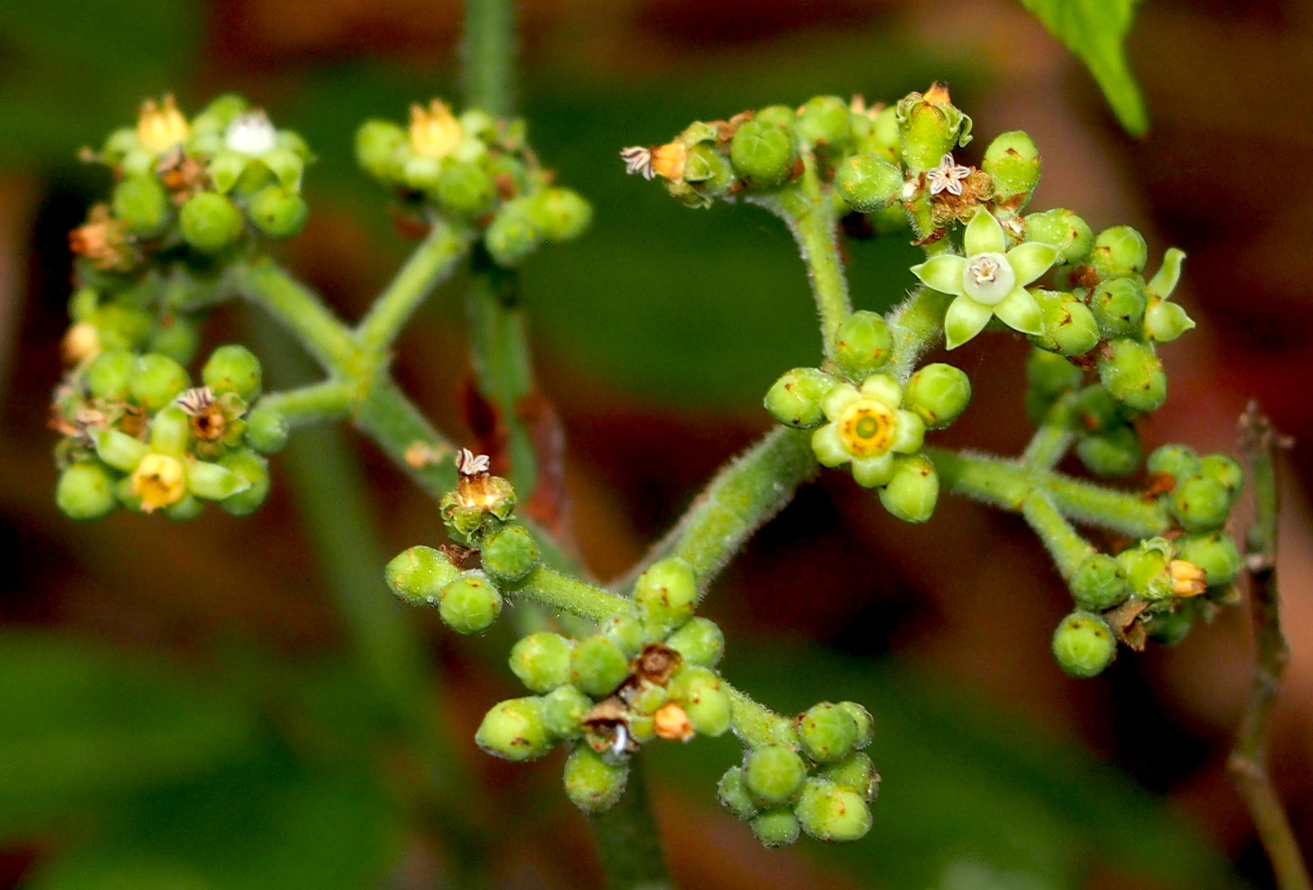
Vitaceae
Acareosperma
Acareosperma spireanum Gagnep
Ituterion
Ituterion arborea
(Forssk.) Raf.
Cissus
Cissus albiporcata Masinde & L.E.Newton.
Leea
Leea macropus
K. Schum. & Lauterb
.
.

Slide 24
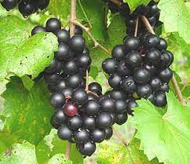
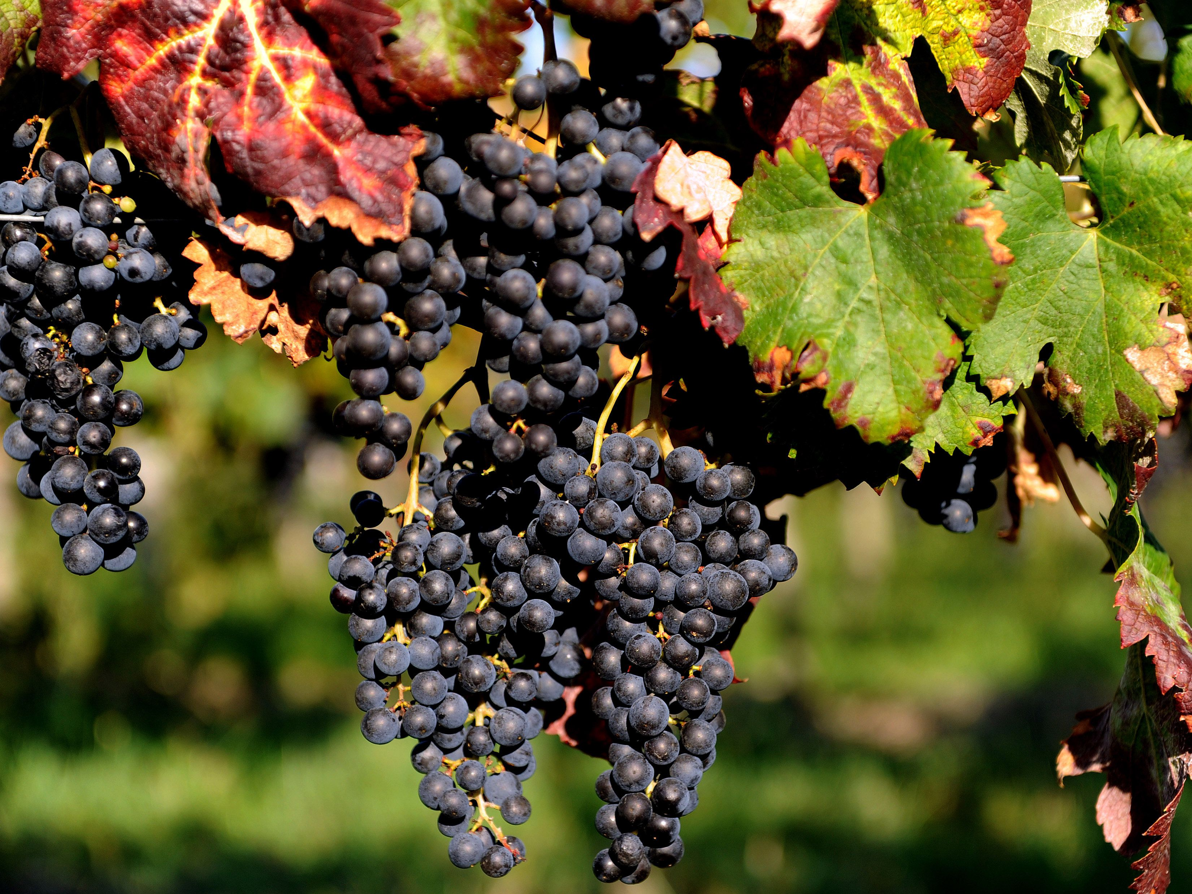
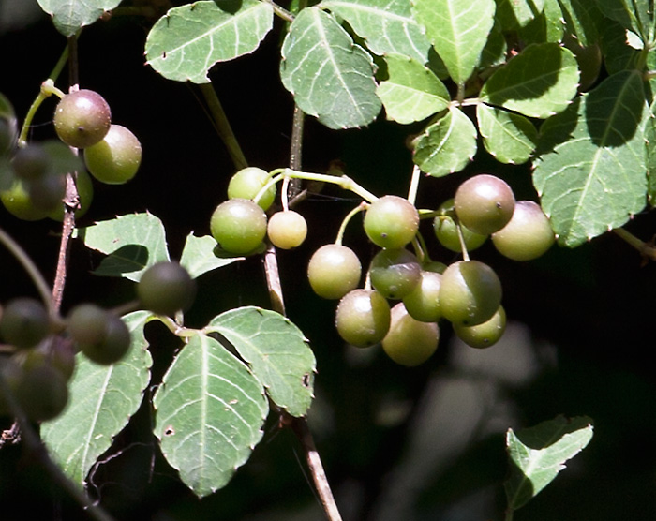
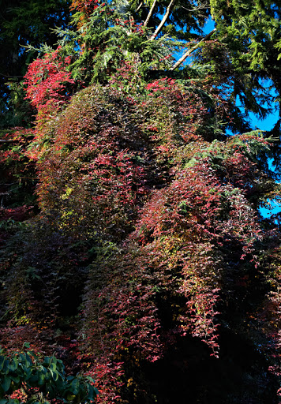
Vitaceae
Muscadinia
Muscadinia munsoniana (J.H. Simpson ex Planch.) Small
Vitis
Vitis vinifera
L.
Tetrastigma , Tetrastigma affine (Gagnep. ex Osmaston) Raizada & H.O. Saxena.
Yua
Yua austro-orientalis
(F.P. Metcalf) C.L. Li
.

Slide 25
Economic importance
Commercial food
Food supplement
Medicinal purposes

Slide 26
Thank you.

